Slide 1
Data Base Management System Unit -3

Slide 2
Functional Dependencies
And
Normalization

Slide 3
Schema Normalization
Decompose relational schemes to
remove redundancy
remove anomalies
Result of normalization:
Semantically-equivalent relational scheme
Represent the same information as the original
Be able to reconstruct the original from decomposed relations.

Slide 4
Functional Dependencies
Motivation: avoid redundancy in database design.
Relation R(A1,...,An,B1,...,Bm,C1,...,Cl)
Definition: A1,...,An functionally determine B1,...,Bm,i.e.,
(A1,...,An →B1,...,Bm)
iff for any two tuples r1 and r2 in R,
r1(A1,...,An ) = r2(A1,...,An )
implies r1(B1,...,Bm) = r2(B1,...,Bm)
By definition: a superkey → all attributes of the relation.
In general, the left-hand side of a FD might not be a superkey.

Slide 5
Example
Take(StudentID, CID, Semster, Grade)
FD: (StudentId,Cid,semester) → Grade
Illegal
What if FD: (StudentId, Cid) → Semester?
Illegal
“Each student can take a course only once.”

Slide 6
FD Sets
A set of FDs on a relation: e.g., R(A,B,C), {A→B, B→C, A→C, AB→A}
Some dependencies can be derived
e.g., A→C can be derived from {A→B, B→C}.
Some dependencies are trivial
e.g., AB→A is “trivial.”

Slide 7
Trivial Dependencies
Those that are true for every relation
A1 A2…An → B1 B2…Bm is trivial if B’s are a subset of the A’s.
Example: XY → X (here X is a subset of XY)
Called nontrivial if none of the B’s is one of the A’s.
Example: AB→C (i.e. there is no such attribute at right side of the FD which is at left side also)

Slide 8
Closure of FD Set
Definition: Let F be a set of FDs of a relation R. We use F⁺ to denote the set of all FDs that must hold over R, i.e.:
F⁺ = { X → Y | F logically implies X → Y}
F⁺ is called the closure of F.
Example: F = {A→B, B→C}, then A→C is in F⁺.
F⁺ could have many FDs!
Example:
Let F = {A→B1, A→B2, ..., A→Bn}, then any A→Y (Y is a subset of {B1, B2, ..., Bn}) is in F+.
Cardinality of F+ is more than 2^n.
Fortunately, a given X→Y can be tested efficiently as we will see later

Slide 9
Armstrong’s Axioms: Inferring All FDs
Given a set of FDs F over a relation R, how to compute F⁺?
Reflexivity:
If Y is a subset of X, then X →Y.
Example: AB→A, ABC→AB, etc.
Augmentation:
If X→Y, then XZ→YZ.
Example: If A→B, then AC→BC.
Transitivity:
If X→Y, and Y→Z, then X→Z.
Example: If AB→C, and C→D, then AB→D.

Slide 10
More Rules Derived from AAs
Union Rule( or additivity):
If X→Y, X→Z, then X→YZ
Projectivity
If X→YZ, then X→Y and X→Z
Pseudo-Transitivity Rule:
If X→Y, WY→Z, then WX→Z

Slide 11
Algo to find closure
To find the closure X+ of X under FDs in F
X+ = X (initialize X+ with X)
Change = true
While change do
Begin
Change = false
For each FD W → Z in F do
Begin
If W C X+ then
X+ = X+ U Z
Change= true
End if
End
End

Slide 12
“Superkey”
Using FDs, we can formally define superkeys.
Given:
R(A1, A2, …,An): a relation
X: a subset of {A1, A2, …An}
F: a set of FDs on R
X is a superkey of R iff X→A1,A2, …,An is in F⁺.
Naïve algorithm to test if X is a superkey:
Compute F⁺ using AAs
If X →A1,A2,…,An is in F⁺, then X is a superkey.
Better algorithm: check if A1,…,An are in X⁺.

Slide 13
Find candidate keys
Given a set F of FDs for a relation, how to find the candidate keys?
One naïve approach: consider each subset X of the relation attribute, and compute X⁺ to see if it includes every attribute.
Tricks:
If an attribute A does not appear in any RHS in FD, A must be in every candidate key
As a consequence, if A must be in every candidate key, and A → B is true, then B should not be in any candidate key.
Example:
R(A,B,C,D,E,F,G,H)
{A → B, ACD → E, EF → GH}
Candidate key: {ACDF}

Slide 14
Equivalent FD Sets
Two sets of FDs F and G are equivalent if F⁺ = G⁺,That is:
Each FD in F can be implied by G; and
Each FD in G can be implied by F
Example:
F = {A→B, B→C, AB→C}
G = {A→B, B→C} F and G are equivalent.
F is minimal if the following is true. If any of the following operation is done, the resulting FD set will not be equivalent to F
Any FD is eliminated from F; or
Any attribute is eliminated from the left side of an FD in F; or
Any attribute is eliminated from the right side of an FD in F.
E.g.: G (above) is a minimal set of FDs of F.
Notes:
8

Slide 15
Examples : Minimizing FDs
Example 1:
F = {A → B, B → C, A → C}
Minimal: F’ = {A → B, B → C}
Remove redundant FD
Example 2:
F = {A → B, B → C, AC → D}
Minimal: F’ = {A → B, B → C, A → D}
Remove attributes from LHS
Example 3:
F = {A → B, B → C, A → CD}
Minimal: F’ = {A → B, B → C, A → D} Remove attributes from RHS
Notes:
8

Slide 16
The Normalization Process
In relational databases the term normalization refers to a reversible step-by-step process in which a given set of relations is decomposed into a set of smaller relations that have a progressively simpler and more regular structure.
The objectives of the normalization process are:
To make it feasible to represent any relation in the database.
applies to First Normal Form
To free relations from undesirable insertion, update and deletion anomalies.
applies to all normal forms

Slide 17
The Normalization Process
The entire normalization process is based upon
the analysis of relations
their schemes
their primary keys
their functional dependencies.

Slide 18
Normalization
Unnormalized Relations
First normal form
Functional dependencyof nonkey attributes on the primary key - Atomic values only
No transitive dependency between nonkey attributes
Second normal form
Third normal form
Boyce-
Codd and
Higher
All determinants are candidate keys - Single multivalued dependency
Full Functional dependencyof nonkey attributes on the primary key

Slide 19
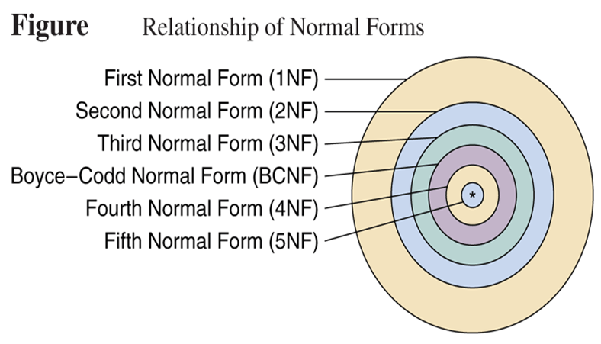
Relationship of Normal Forms

Slide 20
Normal Forms
1st Normal Form | No repeating data groups
2nd Normal Form | No partial key dependency
3rd Normal Form | No transitive dependency
Boyce-Codd Normal Form | Reduce keys dependency
4th Normal Form | No multi-valued dependency
5th Normal Form | No join dependency

Slide 21
Unnormalized Relations
First step in normalization is to convert the data into a two-dimensional table
A relation is said to be unnormalized if does not conatin atomic values.

Slide 22
Eg of Unnormalized Relation

Slide 23
First Normal Form
To move to First Normal Form a relation must contain only atomic values at each row and column.
No repeating groups
Relation in 1NF contains only atomic values.

Slide 24
First Normal Form
Three Formal definitions of First Normal Form
A relation r is said to be in First Normal Form (1NF) if and only if every entry of the relation (each cell) has at most a single value.
A relation is in first normal form (1NF) if and only if all underlying simple domain contains atomic values only.
A relation is in 1NF if and only if all of its attributes are based upon a simple domain.
These two definitions are equivalent.
If all relations of a database are in 1NF, we can say that the database is in 1NF.

Slide 25
Eg of First Normal Form
PROJECT
The normalized representation of the PROJECT table
Proj-ID | Proj-Name | Proj-Mgr-ID | Emp-ID | Emp-Name | Emp-Dpt | Emp-Hrly-Rate | Total-Hrs
100 | E-commerce | 789487453 | 123423479 | Heydary | MIS | 65 | 10
100 | E-commerce | 789487453 | 980808980 | Jones | TechSupport | 45 | 6
100 | E-commerce | 789487453 | 234809000 | Alexander | TechSupport | 35 | 6
100 | E-commerce | 789487453 | 542298973 | Johnson | TechDoc | 30 | 12
110 | Distance-Ed | 820972445 | 432329700 | Mantle | MIS | 50 | 5
110 | Distance-Ed | 820972445 | 689231199 | Richardson | TechSupport | 35 | 12
110 | Distance-Ed | 820972445 | 712093093 | Howard | TechDoc | 30 | 8
120 | Cyber | 980212343 | 834920043 | Lopez | Engineering | 80 | 4
120 | Cyber | 980212343 | 380802233 | Harrison | TechSupport | 35 | 11
120 | Cyber | 980212343 | 553208932 | Olivier | TechDoc | 30 | 12
120 | Cyber | 980212343 | 123423479 | Heydary | MIS | 65 | 07
130 | Nitts | 550227043 | 340783453 | Shaw | MIS | 65 | 07

Slide 26
First Normal Form
This normalized PROJECT table is not a relation because it does not have a primary key.
The attribute Proj-ID no longer identifies uniquely any row.
To transform this table into a relation a primary key needs to be defined.
A suitable PK for this table is the composite key (Proj-ID, Emp-ID)
No other combination of the attributes of the table will work as a PK.

Slide 27
Data Anomalies in 1NF Relations
Redundancies in 1NF relations lead to a variety of data anomalies.
Data anomalies are divided into three general categories of anomalies:
Insertion anomalies occur in this relation because we cannot insert information about any new employee that is going to work for a particular department unless that employee is already assigned to a project.
Deletion anomalies occur in this relation whenever we delete the last tuple of a particular employee, We not only delete the project information that connects that employee to a particular project but also lose other information about the department for which this employee works.
Update anomalies occur in this relation because the department for which an employee works may appear many times in the table.
It is this redundancy of information that causes the anomaly because if an employee moves to another department, we are now faced with two problems:
We either search the entire table looking for that employee and update his/her Emp-Dpt value
We miss one or more tuples of that employee and end up with an inconsistent database.

Slide 28
Partial Dependencies
Identifying the partial dependencies in the PROJECT-EMPLOYEE relation.
The PK of this relation is formed by the attributes Proj-ID and Emp-ID.
This implies that {Proj-ID, Emp-ID} uniquely identifies a tuple in the relation.
They functionally determine any individual attribute or any combination of attributes of the relation.
However, we only need attribute Emp-ID to functionally determine the following attributes:
Emp-Name, Emp-Dpt, Emp-Hrly-Rate.

Slide 29
Second Normal Form
And we need only Proj-Id attribute to functionally determine proj_name and Proj_Mgr_Id.
So we decompose the relation into following two relations:
PROJECT
Proj-ID | Proj-Name | Proj-Mgr-ID
100 | E-commerce | 789487453
110 | Distance-Ed | 820972445
120 | Cyber | 980212343
130 | Nitts | 550227043

Slide 30
Second Normal Form
PROJECT-EMPLOYEE
Emp-ID | Emp-Name | Emp-Dpt | Emp-Hrly-Rate
123423479 | Heydary | MIS | 65
980808980 | Jones | TechSupport | 45
234809000 | Alexander | TechSupport | 35
542298973 | Johnson | TechDoc | 30
432329700 | Mantle | MIS | 50
689231199 | Richardson | TechSupport | 35
712093093 | Howard | TechDoc | 30
834920043 | Lopez | Engineering | 80
380802233 | Harrison | TechSupport | 35
553208932 | Olivier | TechDoc | 30
340783453 | Shaw | MIS | 65

Slide 31
There are no partial dependencies in both the tables because the determinant of the key only has a single attribute.
For eg:
To relate these two relations, we create a third table (relationship table) that consists of the primary keys of both the relations as foreign key and an attribute ‘Total-Hrs-Worked’ because it is fully dependent on the key of the relation {Proj-Id, Emp-Id}.
Proj-ID
Emp-ID
Emp-Name
Emp-Dpt
Emp-Hrly-Rate

Slide 32
Second Normal Form
A relation is said to be in Second Normal Form if is in 1NF and when every non key attribute is fully functionally dependent on the primary key.
Or No nonprime attribute is partially dependent on any key .
Now, the example relation scheme is in 2NF with following relations:
Project (Proj-Id, Proj-Name, Proj-Mgr-Id)
Employee (Emp-Id, Emp-Name, Emp_dept, Emp-Hrly-Rate )
Proj_Emp (Proj-id, Emp-Id, Total-Hrs-Worked)

Slide 33
Data Anomalies in 2NF Relations
Insertion anomalies occur in the EMPLOYEE relation.
Consider a situation where we would like to set in advance the rate to be charged by the employees of a new department.
We cannot insert this information until there is an employee assigned to that department.
Notice that the rate that a department charges is independent of whether or not it has employees.

Slide 34
Data Anomalies in 2NF Relations
The EMPLOYEE relation is also susceptible to deletion anomalies.
This type of anomaly occurs whenever we delete the tuple of an employee who happens to be the only employee left in a department.
In this case, we will also lose the information about the rate that the department charges.

Slide 35
Data Anomalies in 2NF Relations
Update anomalies will also occur in the EMPLOYEE relation because there may be several employees from the same department working on different projects.
If the department rate changes, we need to make sure that the corresponding rate is changed for all employees that work for that department.
Otherwise the database may end up in an inconsistent state.

Slide 36
Transitive Dependencies
A transitive dependency is a functional dependency which holds by virtue of transitivity. A transitive dependency can occur only in a relation that has three or more attributes. Let A, B, and C designate three distinct attributes and following conditions hold:
A → B (where A is the key of the relation)
B → C
Then the functional dependency A → C (which follows from 1 and 3 by the axiom of transitivity) is a transitive dependency.
For eg: If in a relation Book is the key and
{Book} → {Author}
{Author} → {Nationality}
Therefore {Book} → {Nationality} is a transitive dependency.
Transitive dependency occurs when a non-key attribute determines another non-key attribute.

Slide 37
Transitive Dependencies
Assume the following functional dependencies of attributes A, B and C of relation r(R):
A
B
C

Slide 38
Third Normal Form
A relation is in 3NF iff it is in 2NF and every non key attribute is non transitively dependent on the primary key.
A relation r(R) is in Third Normal Form (3NF) if and only if the following conditions are satisfied simultaneously:
r(R) is already in 2NF.
No nonprime attribute is transitively dependent on the key.
The objective of transforming relations into 3NF is to remove all transitive dependencies.
Given a relation R with FDs F, test if R is in 3NF.
Compute all the candidate keys of R
For each X→Y in F, check if it violates 3NF
If X is not a superkey, and Y is not part of a candidate key, then X→Y violates 3NF.

Slide 39
Conversion to Third Normal Form
A*
A*
B
B
C
Convert to
B*
* indicates the key or the determinant of the relation.
C

Slide 40
Third Normal Form
Using the general procedure, we will transform our 2NF relation example to a 3NF relation.
The relation EMPLOYEE is not in 3NF because there is a transitive dependency of a nonprime attribute on the primary key of the relation.
In this case, the nonprime attribute Emp-Hrly-Rate is transitively dependent on the key through the functional dependency Emp-Dpt → Emp-Hrly-Rate.
To transform this relation into a 3NF relation:
it is necessary to remove any transitive dependency of a nonprime attribute on the key.
It is necessary to create two new relations.

Slide 41
Third Normal Form
The scheme of the first relation that we have named EMPLOYEE is:
EMPLOYEE (Emp-ID, Emp-Name, Emp-Dpt)
The scheme of the second relation that we have named CHARGES is:
CHARGES (Emp-Dpt, Emp-Hrly-Rate)

Slide 42
Algorithm: decomposing R into 3NF
Input: a relation R with a set F of FDs
Output: a set of 3NF relations preserving F and do not lose info.
Step 1: Merge FDs with the same left-hand side.
Step 2: Minimize F and get F’
Step 3: For each X →Y in F’, create a relation with schema XY
Step 4: Eliminate a relation schema that is a subset of another.
Step 5: If no relations contain a candidate key of R, create a relation to include a candidate key of R.
Notes:
16

Slide 43
Example 1
R = ABCD, F = {A → B, B → C, AC → D}
Candidate key: {A}
Step 1: nothing
Step 2: Minimal F’ = {A → B, B → C, A → D}
Step 3: create relations:
For A→B, create a relation R1(A,B)
For B→C, create a relation R2(B,C)
For A→D, create a relation R3(A,D)
Step 4: do nothing
Step 5: do nothing, since candidate key A is in A→B
Result: R1(A,B), R2(B,C), R3(A,D)
Notes:
17

Slide 44
Example 2
R(A,B,C,D,E,F,G,H)
F = {A→B, ABCD→E, EF→G, EF→H, ACDF→EG}
After step 1: F1 = {A→B, ABCD→E, EF → GH, ACDF → EG}
In step 2:
Remove attribute B from LHS of ABCD→E
Remove E from RHS of ACDF→EG
Remove ACDF →G
Result: F2 = {A → B, ACD → E, EF → GH}
Candidate key: {ACDF}
Step 3: create relations:
A→B: create a relation R1(A, B)
ACD→E: create a relation R2(A, C, D, E)
EF→GH: create a relation R3(E, F, G, H)
Step 4: do nothing
Step 5: ACDF is a candidate key, so create a relation R4(A,C,D,F)
Result: R1(A,B), R2(A,C,D,E), R3(E,F,G,H), R4(A,C,D,F)

Slide 45
Data Anomalies in Third Normal Form
The Third Normal Form helped us to get rid of the data anomalies caused either by
transitive dependencies on the PK or
by dependencies of a nonprime attribute on another nonprime attribute.
However, relations in 3NF are still susceptible to data anomalies, particularly when
the relations have two overlapping candidate keys or
when a nonprime attribute functionally determines a prime attribute.

Slide 46
Boyce-Codd Normal Form (BCNF)
A relation is in BCNF iff every determinant is a candidate key.
OR
In other words, a relational schema R is in Boyce–Codd normal form if and only if for every one of its dependencies X → Y, at least one of the following conditions hold:
X → Y is a trivial functional dependency (Y ⊆ X)
X is a superkey for schema R
The definition of 3NF does not deal with a relation that:
has multiple candidate keys, where
those candidate keys are composite, and
the candidate keys overlap (i.e., have at least one common attribute)

Slide 47
Example of BCNF
Candidate keys are (sid, part_id)
and (sname, part_id).
With following FDs:
{ sid, part_id } → qty
{ sname, part_id } → qty
sid → sname
sname → sid
The relation is in 3NF:
For sid → sname, … sname is in a candidate key.
For sname → sid, … sid is in a candidate key.
However, this leads to redundancy and loss of information
sname
part_id
sid
qty
SSP

Slide 48
Example of BCNF
If we decompose the schema into
R₁ = ( sid, sname ), R₂ = ( sid, part_id, qty )
These are in BCNF.
The decomposition is dependency preserving.
{ sname, part_id } → qty can be deduced from
sname → sid (given)
{ sname, part_id } → { sid, part_id } (augmentation on (1))
{ sid, part_id } → qty (given)
and finally transitivity on (2) and (3).

Slide 49
3NF vs BCNF
Only in rare cases does a 3NF table not meet the requirements of BCNF. A 3NF table which does not have multiple overlapping candidate keys is guaranteed to be in BCNF. Depending on what its functional dependencies are, a 3NF table with two or more overlapping candidate keys may or may not be in BCNF.
If a relation schema is not in BCNF
it is possible to obtain a lossless-join decomposition into a collection of BCNF relation schemas.
Dependency-preserving is not guaranteed.
3NF
There is always a dependency-preserving, lossless-join decomposition into a collection of 3NF relation schemas.

Slide 50
Properties of a good Decomposition
A decomposition of a relation R into sub-relations R1, R2,……., Rn should possess following properties:
The decomposition should be
Attribute Preserving ( All the attributes in the given relation must occur in any of the sub – relations)
Dependency Preserving ( All the FDs in the given relation must be preserved in the decomposed relations)
Lossless join ( The natural join of decomposed relations should produce the same original relation back, without any spurious tuples).
No redundancy ( The redundancy should be minimized in the decomposed relations).

Slide 51
Lossless Join Decomposition
The relation schemas { R₁, R₂, …, R_{n} } is a lossless-join decomposition of R if:
for all possible relations r on schema R,
r = Π_{R1}( r ) Π _{R2}( r ) … Π _{Rn} ( r )
Example:
Student = ( sid, sname, major)
F = { sid → sname, sid → major}
{ sid, sname } + { sid, major } is a lossless join decomposition
the intersection = {sid} is a key in both schemas
{sid, major} + { sname, major } is not a lossless join decomposition
the intersection = {major} is not a key in either
{sid, major} or { sname, major }

Slide 52
Another Example
R = { A, B, C, D }
F = { A → B, C → D }.
Key is {AC}.
introduce
virtually
Decomposition: { (A, B), (C, D), (A, C) }
Consider it a two step decomposition:
Decompose R into R₁ = (A, B), R₂ = (A, C, D)
Decompose R₂ into R₃ = (C, D), R₄ = (A, C)
This is a lossless join decomposition.
If R is decomposed into (A, B), (C, D)
This is a lossy-join decomposition.

Slide 53
Checking Lossless Join Decomposition - α Test
Example 1: Let us consider a relation R(A,B,C,D,E)
With FDs
{A->BC, C->D, D->B, B->E, A->E}
Is decomposed into following 3 relations:
R1(A,B,C)
R2(C,D)
R3(B,D,E)
Then check the decompositions by test.
Initialize the table with α in the cell where an attribute exists for the corresponding relation as follows:
Now update the table while placing α and check whether any row contains α in all the columns. If so, then the decomposition is lossless.
In this example the second table contains all α’s in the first row. So the decomposition is lossless.
 | A | B | C | D | E
R1 | α | α | α
R2 |  |  | α | α
R3 |  | α |  | α | α
 | A | B | C | D | E
R1 | α | α | α | α | α
R2 |  | α | α | α | α
R3 |  | α |  | α | α

Slide 54
Fourth Normal Form
A relation R is in 4NF if and only if it satisfies following conditions:
If R is already in 3NF or in BCNF.
If it contains no multi valued dependencies.
MVDs occur when two or more independent multi valued facts about the same attribute occur within the same relation.
This means that if in a relation R, having A, B and C attributes, B and C are multi valued represented as A→→B and A→→C, then MVD exists only if B and C are independent of each other.

Slide 55
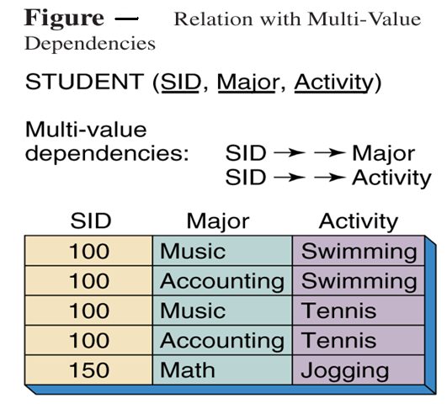
Example: 4NF

Slide 56
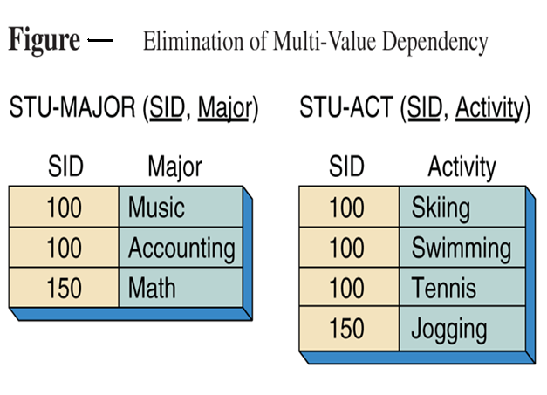
Example: 4NF

Slide 57
Fifth Normal Form
A relation R is in 5NF (also called Projection-Join Normal form or PJNF) iff every join dependency in the relation R is implied by the candidate keys of the relation R.
A relation decomposed into two relations must have lossless join property, which ensures that no spurious tuples are generated when relations are reunited using a natural join.
There are requirements to decompose a relation into more than two relations. Such cases are managed by join dependency and 5NF.
Implies that relations that have been decomposed in previous NF can be recombined via natural joins to recreate the original relation.

Slide 58
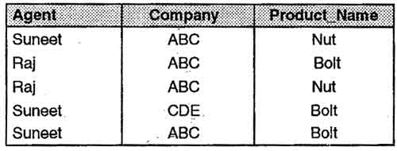
Fifth Normal Form
Consider the different case where, if an agent is an agent for a company and that company makes a product, then he always sells that product for the company. Under these circumstances, the 'agent company product' table is as shown below . This relation contains following dependencies.
Agent →→ Company
Agent →→ Product_Name
Company→→Product_Name

Slide 59
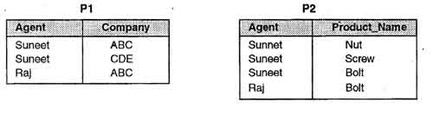
Fifth Normal Form
The table is necessary in order to show all the information required. Suneet, for example, sells ABC's Nuts and Screws, but not ABC's Bolts. Raj is not an agent for CDE and does not sell ABC's Nuts or Screws. The table is in 4NF because it contains no multi-valued dependency. It does, however, contain an element of redundancy in that it records the fact that Suneet is an agent for ABC twice. Suppose that the table is decomposed into its two projections, PI and P2.
The redundancy has been eliminated, but the information about which companies make which products and which of these products they supply to which agents has been lost. The natural join of these two projections will result in some spurious tuples (additional tuples which were not present in the original relation).

Slide 60
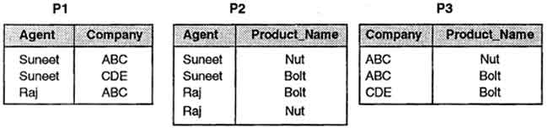
Fifth Normal Form
This table can be decomposed into its three projections without loss of information as demonstrated below .
If we take the natural join of these relations then we get the original relation back. So this is the correct decomposition.

Slide 61
PL/SQL Programming

Slide 62
PL/SQL
PL/SQL is Oracle's procedural language extension to SQL, the non-procedural relational database language.
With PL/SQL, you can use SQL statements to manipulate ORACLE data and the flow of control statements to process the data. Moreover, you can declare constants and variables, define subprograms (procedures and functions), and trap runtime errors. Thus, PL/SQL combines the data manipulating power of SQL with the data processing power of procedural languages.

Slide 63
PL/SQL
Many Oracle applications are built using client-server architecture. The Oracle database resides on the server.
The program that makes requests against this database resides on the client machine.
This program can be written in C, Java, or PL/SQL.
While PL/SQL is just like any other programming language, it has syntax and rules that determine how programming statements work together. It is important for you to realize that PL/SQL is not a stand-alone programming language.
PL/SQL is a part of the Oracle RDBMS, and it can reside in two environments, the client and the server.

Slide 64
PL/SQL
As a result, it is very easy to move PL/SQL modules between server-side and client-side applications.
When the PL/SQL engine is located on the server, the whole PL/SQL block is passed to the PL/SQL engine on the Oracle server.
The PL/SQL engine processes the block according to the Figure 2.1.

Slide 65
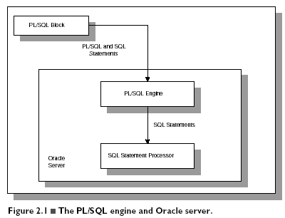

Slide 66
PL/SQL
When the PL/SQL engine is located on the client, as it is in the Oracle Developer Tools, the PL/SQL processing is done on the client side.
All SQL statements that are embedded within the PL/SQL block are sent to the Oracle server for further processing. When PL/SQL block contains no SQL statement, the entire block is executed on the client side.

Slide 67
DIFFERENCE BETWEEN PL/SQL AND SQL
When a SQL statement is issued on the client computer, the request is made to the database on the server, and the result set is sent back to the client.
As a result, a single SQL statement causes two trips on the network. If multiple SELECT statements are issued, the network traffic increase significantly very fast. For example, four SELECT statements cause eight network trips.
If these statements are part of the PL/SQL block, they are sent to the server as a single unit. The SQL statements in this PL/SQL program are executed at the server and the result set is sent back as a single unit. There is still only one network trip made as is in case of a single SELECT statement.

Slide 68
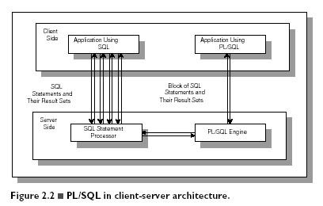
Comparison of SQL*PLUS and PL/SQL

Slide 69
PL/SQL BLOCKS
PL/SQL blocks can be divided into two groups:
Named and
Anonymous.
Named blocks are used when creating subroutines. These subroutines are procedures, functions, and packages.
The subroutines can be stored in the database and referenced by their names later on.
In addition, subroutines can be defined within the anonymous PL/SQL block.
Anonymous PL/SQL blocks do not have names. As a result,they cannot be stored in the database and referenced later.

Slide 70
PL/SQL BLOCK STRUCTURE
PL/SQL blocks contain three sections
Declare section
Executable section and
Exception-handling section.
The executable section is the only mandatory section of the block.
Both the declaration and exception-handling sections are optional.

Slide 71
PL/SQL BLOCK STRUCTURE
PL/SQL block has the following structure:
DECLARE
Declaration statements
BEGIN
Executable statements
EXCETION
Exception-handling statements
END ;

Slide 72
DECLARATION SECTION
The declaration section is the first section of the PL/SQL block.
It contains definitions of PL/SQL identifiers such as variables, constants, cursors and so on.
Example
DECLARE
v_first_name VARCHAR2(35) ;
v_last_name VARCHAR2(35) ;
v_counter NUMBER := 0 ;

Slide 73
EXECUTABLE SECTION
The executable section is the next section of the PL/SQL block.
This section contains executable statements that allow you to manipulate the variables that have been declared in the declaration section.
BEGIN
SELECT first_name, last_name
INTO v_first_name, v_last_name
FROM student
WHERE student_id = 123 ;
DBMS_OUTPUT.PUT_LINE
(‘Student name :’ || v_first_name ||‘ ’|| v_last_name);
END;

Slide 74
EXCEPTION-HANDLING SECTION
The exception-handling section is the last section of the PL/SQL block.
This section contains statements that are executed when a runtime error occurs within a block.
Runtime errors occur while the program is running and cannot be detected by the PL/SQL compiler.
EXCEPTION
WHEN NO_DATA_FOUND THEN
DBMS_OUTPUT.PUT_LINE
(‘ There is no student with student id 123 ’);
END;

Slide 75
HOW PL/SQL GETS EXECUTED
Every time an anonymous block is executed, the code is sent to the PL/SQL engine on the server where it is compiled.
The named PL/SQL block is compiled only at the time of its creation, or if it has been changed.
The compilation process includes syntax checking, binding and p-code generation.
Syntax checking involves checking PL/SQL code for syntax or compilation errors.
Once the programmer corrects syntax errors, the compiler can assign a storage address to program variables that are used to hold data for Oracle. This process is called Binding.

Slide 76
HOW PL/SQL GETS EXECUTED
After binding, p-code is generated for the PL/SQL block.
P-code is a list of instructions to the PL/SQL engine.
For named blocks, p-code is stored in the database, and it is used the next time the program is executed.
Once the process of compilation has completed successfully, the status for a named PL/SQL block is set to VALID, and also stored in the database.
If the compilation process was not successful, the status for a named PL/SQL block is set to INVALID.

Slide 77
Structure of PL/SQL
PL/SQL is Block Structured
A block is the basic unit from which all PL/SQL programs are built. A block can be named (functions and procedures) or anonymous
Sections of block
1- Header Section
2- Declaration Section
3- Executable Section
4- Exception Section

Slide 78
Structure of PL/SQL
HEADER
Type and Name of block
DECLARE
Variables; Constants; Cursors;
BEGIN
PL/SQL and SQL Statements
EXCEPTION
Exception handlers
END;

Slide 79
Structure of PL/SQL
DECLARE
a number;
text1 varchar2(20);
text2 varchar2(20) := “HI”;
BEGIN
---------- ---------- ----------
END;
Important Data Types in PL/SQL include NUMBER, INTEGER, CHAR, VARCHAR2, DATE etc
to_date(‘02-05-2007','dd-mm-yyyy') { Converts String to Date}

Slide 80
Structure of PL/SQL
Data Types for specific columns
Variable_name Table_name.Column_name%type;
This syntax defines a variable of the type of the referenced column on the referenced table

Slide 81
PL/SQL Control Structure
PL/SQL has a number of control structures which includes:
Conditional controls
Iterative or loop controls.
Exception or error controls
It is these controls, used singly or together, that allow the PL/SQL developer to direct the flow of execution through the program.

Slide 82
PL/SQL Control Structure
Conditional Controls
IF....THEN....END IF;
IF....THEN...ELSE....END IF;
IF....THEN...ELSIF....THEN....ELSE....END IF;

Slide 83
PL/SQL Control Structure
LOOP
...SQL Statements...
EXIT;
END LOOP;
WHILE loops
WHILE condition LOOP
...SQL Statements...
END LOOP;
FOR loops
FOR <variable(numeric)> IN [REVERSE] <lowerbound>..<upperbound> LOOP .... ..... END LOOP;

Slide 84
PL/SQL Control Structure
Cursor
DECLARE name varchar2(20);
Cursor c1 is
select t.name
from table t
where date is not null;
BEGIN
OPEN c1;
LOOP
FETCH c1 into name;
exit when c1%NOTFOUND;
END LOOP;
CLOSE c1;
END;

Slide 85
EXECUTING PL/SQL
PL/SQL can be executed directly in SQL*Plus. A PL/SQL program is normally saved with an .sql extension. To execute an anonymous PL/SQL program, simply type the following command at the SQL prompt:
SQL> @DisplayAge

Slide 86
GENERATING OUTPUT
Like other programming languages, PL/SQL provides a procedure (i.e. PUT_LINE) to allow the user to display the output on the screen. For a user to able to view a result on the screen, two steps are required.
First, before executing any PL/SQL program, type the following command at the SQL prompt (Note: you need to type in this command only once for every SQL*PLUS session):
SQL> SET SERVEROUTPUT ON;
or put the command at the beginning of the program, right before the declaration section.

Slide 87
GENERATING OUTPUT
Second, use DBMS_OUTPUT.PUT_LINE in your executable section to display any message you want to the screen.
Syntax for displaying a message:
DBMS_OUTPUT.PUT_LINE(<string>);
in which PUT_LINE is the procedure to generate the output on the screen, and DBMS_OUTPUT is the package to which the PUT_LINE belongs.
DBMS_OUTPUT_PUT_LINE(‘My age is ‘ || num_age);

Slide 88
THANK YOU

